Slide 1
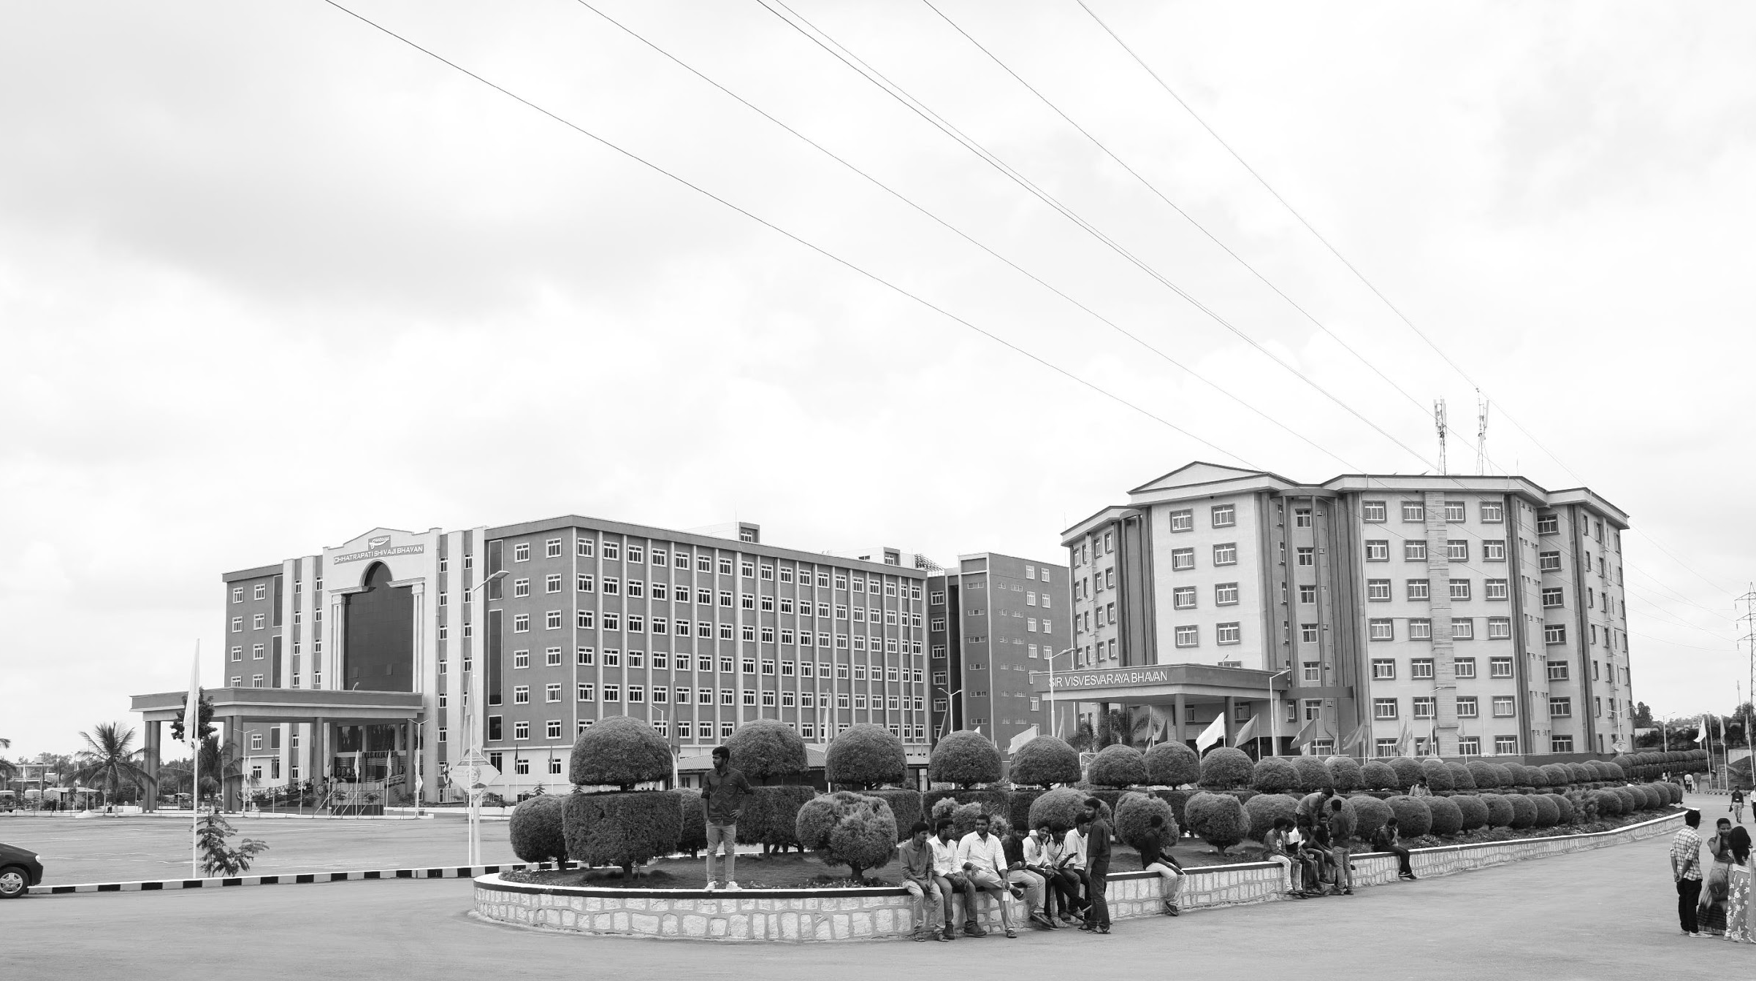

An Adaptive Modulation For Free Space Optical (FSO) Systems
Review-II
AY 2025-26
Capstone Project – Introduction (PROJ2999)
GITAM (Deemed-to-be) University
Department of Electrical Electronics and Communication Engineering
Project Team:
Hari Pawar
Saiprajwalreddy
Laxmiprasad Sindageri
Project Mentor:
Rohan Prasad
Project In-charge:
Subhashish Tiwari
www.gitam.edu

Slide 2
Objective and Goals
Objective
To implement MPPM modulation and demodulation for FSO communication in MATLAB.
To model weather effects (fog, haze, rain) using visibility-based attenuation and turbulence.
To estimate channel SNR and evaluate BER under varying conditions.
To design an adaptive modulation algorithm that selects the best (M,K) mode.
To compare adaptive MPPM with fixed MPPM in terms of BER and throughput.
Goals
Main Goals
To develop an FSO communication system using MPPM modulation.
To analyze how different weather conditions affect FSO link performance.
To design a channel-adaptive algorithm that selects the best MPPM mode automatically.

Slide 3
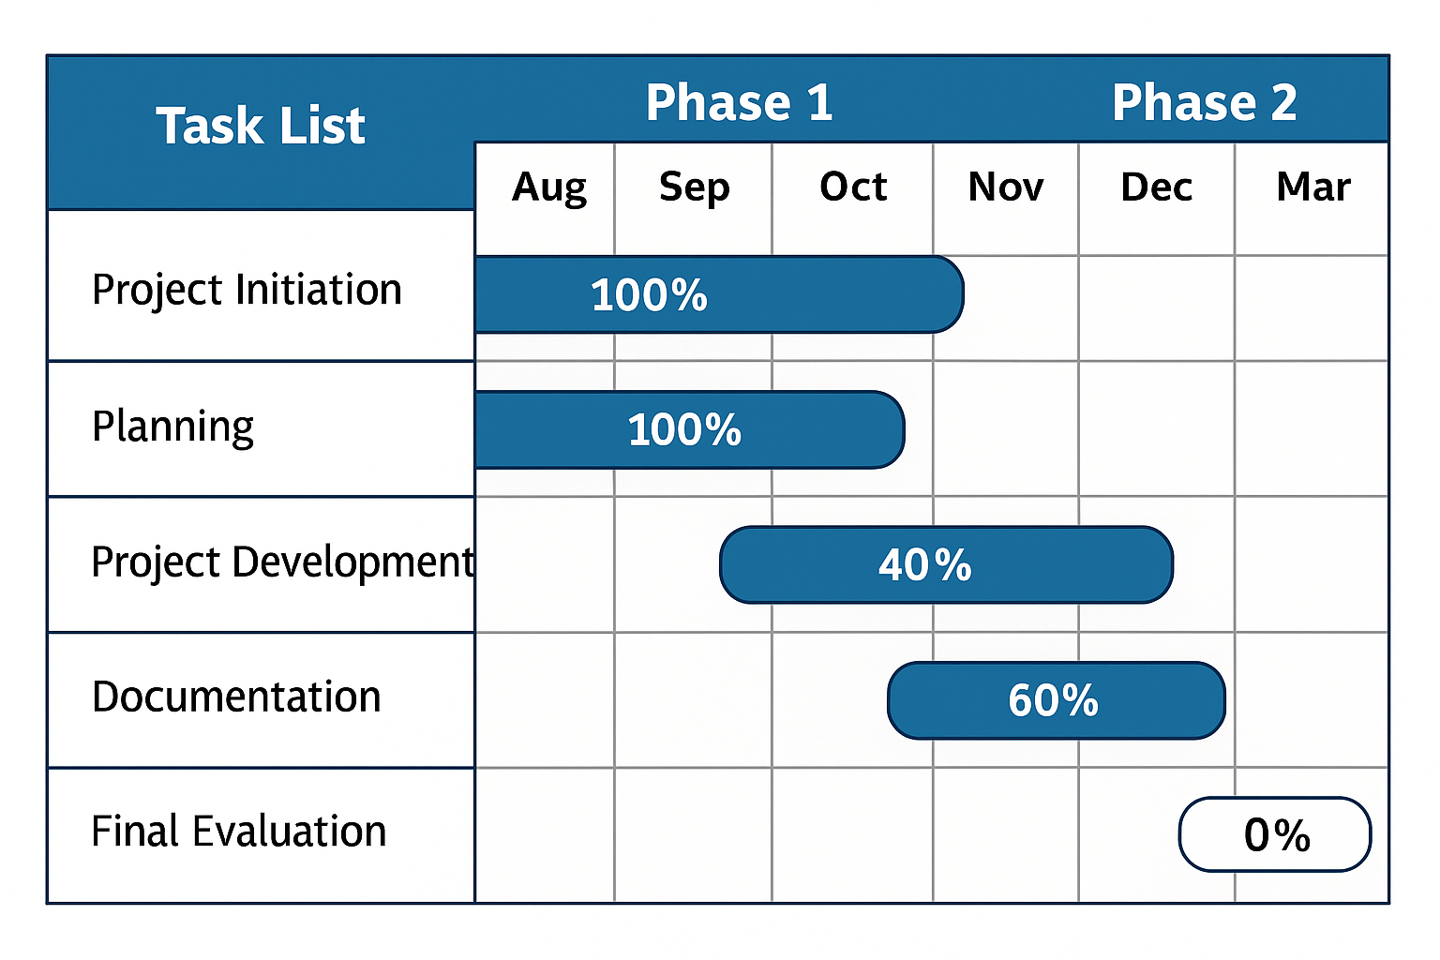
Project Plan

Slide 4
Literature Survey
Key Publications
1)Adaptive Coded Modulation for IM/DD Free-Space Optical Backhauling.
Author: Ahmed Elzanaty and Mohamed-Slim Alouini.
Journal:Google Scholar
Key Takeaways: The paper proposes SpaDCoM, which uses probabilistic shaping (CCDM) + binary FEC to transmit a mix of shaped (sparse) and uniform (dense) symbols over FSO links. This design adapts to turbulence, works close to channel capacity (within 0.2 dB), saves power, and remains practical with standard FEC codes.
2) Adaptive Subcarrier PSK Intensity Modulation in Free-Space Optical Systems
Author: Nestor D. Chatzidiamantis, Athanasios S. Lioumpas, George K. Karagiannidis, Shlomi Arnon.
Journal:Google Scholar
Key Takeaways: This paper shows that Adaptive S-PSK Intensity Modulation allows FSO links to change modulation order depending on turbulence, improving spectral efficiency and reliability while keeping BER under control. It works best in moderate-to-strong turbulence and can be further enhanced with MIMO apertures.
3)Power Control and Adaptive Digital Pulse Interval Modulation for Free Space Optical Links.
Author: Mohammad Taghi Dabiri, Mohammad Javad Saber, and Seyed Mohammad Sajad Sadough
Journal:Google Scholar
Key Takeaways:The proposed technique uses Power Control combined with an Adaptive Digital Pulse Interval Modulation (DPIM) scheme to significantly mitigate the performance degradation caused by atmospheric turbulence (like scintillation and fading) in Free Space Optical (FSO) links, thereby achieving more reliable and efficient communication
.

Slide 5
Literature Survey
4)Performance analysis of an adaptive optics system for free-space optics communication through atmospheric turbulence.
Author: Yukun Wang, Huanyu Xu, Dayu Li, Rui Wang, Chengbin Jin, Xianghui Yin, Shijie Gao, Quanquan Mu, Li Xuan & Zhaoliang Cao
Journal: Google Scholar
Key Takeaways: This paper demonstrates that adaptive optics, if properly designed can dramatically improve the reliability and performance of free-space optical links under turbulence.
5)Adaptive Modulation for FSO IM/DD Systems With Multiple Transmitters and Receivers
Author: Hatef Nouri, Sadiq M. Sait, and Murat Uysal .
Journal:Google Scholar
Key Takeaways: This 2023 paper proposes adaptive modulation for multi-aperture IM/DD FSO systems, achieving much higher spectral efficiency and reliability compared to non-adaptive or single-aperture systems, particularly in turbulent channels.
6) Adaptive Coded Modulation for FSO Links
Author: K. Fatima, S. Sheikh Muhammad and Erich Leitgeb
Journal:Google Scholar
Key Takeaways: This 2012 paper shows that adaptive coded modulation (ACM) using PAM/PPM + LDPC improves FSO links by dynamically adjusting to weather/turbulence, achieving both high throughput in good channels and strong reliability in adverse ones.

Slide 6
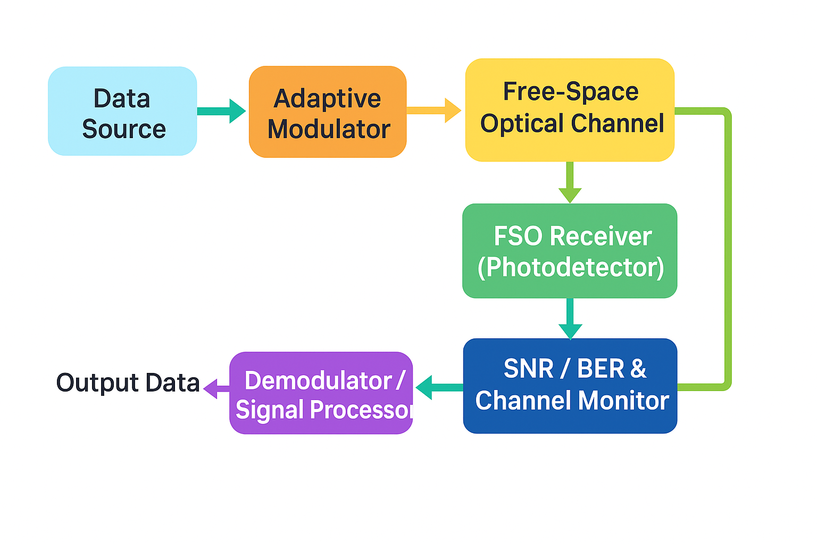
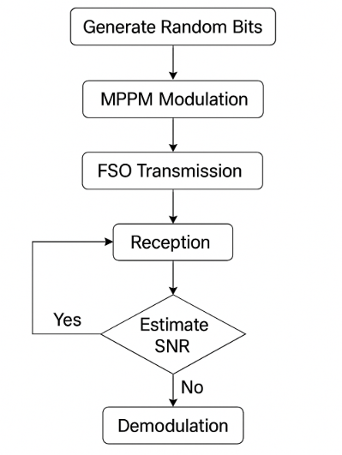
Architecture
Structural Diagram
Block Diagram :
FLOW CHART:

Slide 7
Use Cases & Testing
Use Cases
The system generates random bits to simulate real data for transmission.
The bits are encoded into MPPM symbols based on selected M and K values
The encoded symbols are sent through the FSO channel affected by fog, haze, and noise.
The receiver detects the pulses, demodulates the signal, and reconstructs the bits.
The system monitors channel quality and switches to a better modulation mode when visibility becomes poor.
Test Cases
The system is tested to ensure the modulator produces correct MPPM symbols with the right number of pulses.
The demodulator is verified by checking that it perfectly recovers the original bits when no channel effects are added.
The FSO channel model is validated by observing that BER increases as visibility decreases
Adaptive modulation is tested to confirm that the system changes (M,K) settings automatically under poor channel conditions
Noise performance is tested by checking that BER becomes worse as noise level increases.

Slide 8
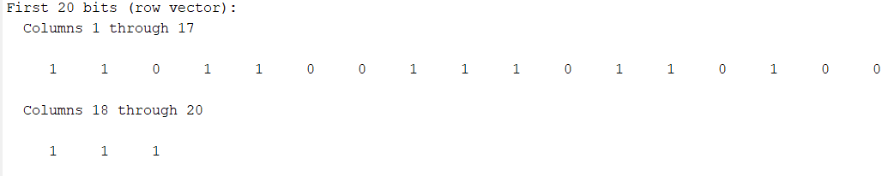
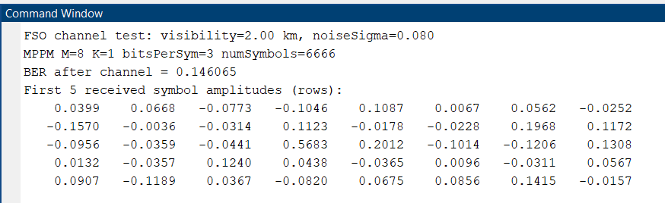
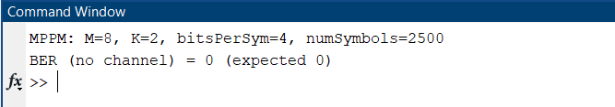
Implementation and Results – Iteration 1
Iteration 1 : Results

Slide 9
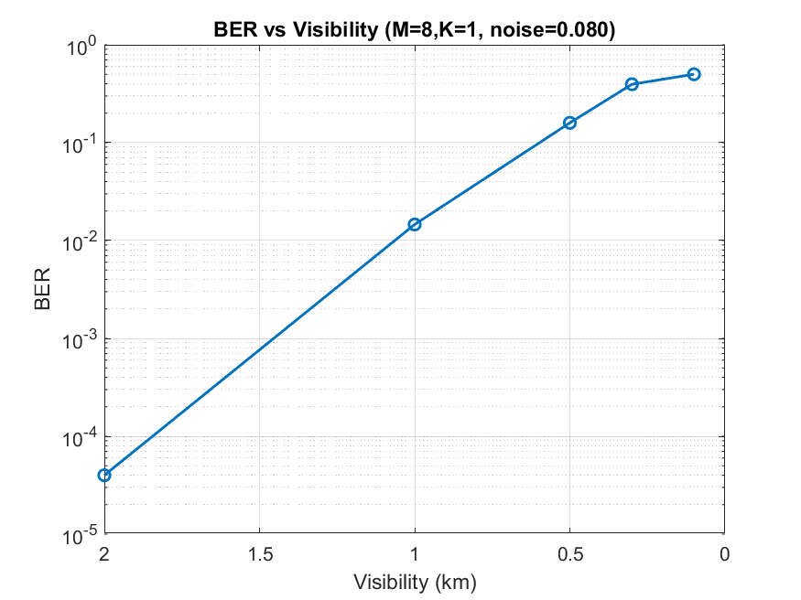
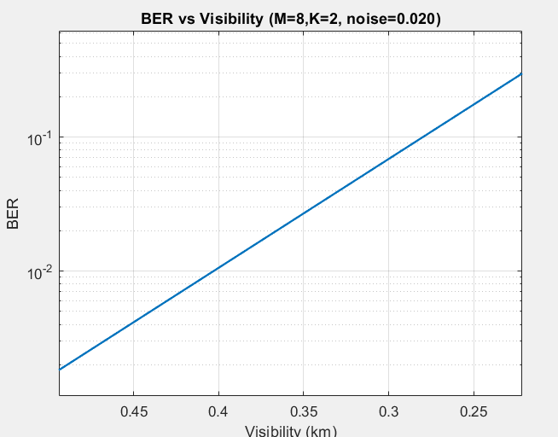
Implementation and Results – Iteration 2
Iteration : Results

Slide 10
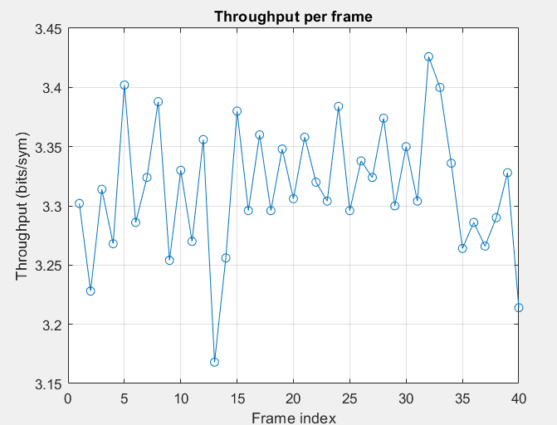
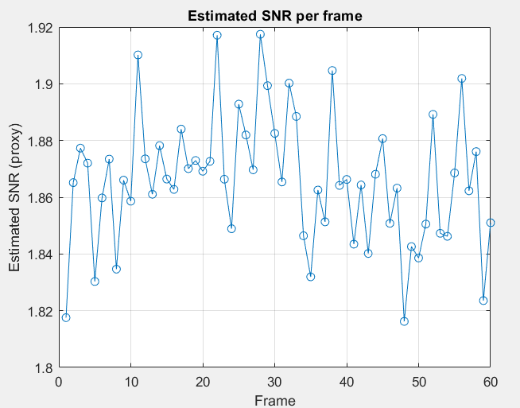
Implementation and Results – Iteration 2
Iteration : Results

Slide 11
Conclusion & Future Work
Summary and Conclusion
The project successfully implemented an MPPM-based FSO communication system with realistic channel modeling, including visibility attenuation, turbulence, and noise. Modulation and demodulation were verified with zero BER in ideal conditions, and BER was analyzed under different weather scenarios, showing expected performance degradation with reduced visibility. An adaptive algorithm using SNR feedback was also developed, enabling automatic switching of (M,K) modes.
Overall, results show that adaptive MPPM significantly improves reliability and throughput compared to fixed modes, proving it to be an effective technique for FSO links under varying atmospheric conditions.
Future Work
Future work will focus on improving the adaptive modulation algorithm with more accurate SNR thresholds and advanced weather modeling, including pointing errors and beam wander. Higher-order and hybrid MPPM schemes will be explored to increase throughput under good channel conditions. The system will be tested with long-term adaptive simulations to study performance under continuously varying weather.

Slide 12
THANK YOU
Have a Great Day !

